Slide 1


A multi-time-scale wall model for Large Eddy Simulation of non-equilibrium flows
Dissertation Defense
Presenter: Mitchell Fowler
Advisors: Charles Meneveau, Tamer Zaki
Monday, November 13, 2023
Research supported by ONR
Notes:
Thank you Charles/Tamer for the introduction. I’m excited to introduce the research I have been working on over the course of my PhD. In particular I will be discussing a multi-time-scale wall model for Large Eddy Simulation of non-equilibrium flows.

Slide 2
Outline
Chapter
Introduction
The Lagrangian Relaxation Towards Equilibrium (LaRTE) model
The laminar non-equilibrium (lamNEQ) model
Applications of the LaRTE+lamNEQ wall model to equilibrium and non-equilibrium channel flows
The multi-time-scale wall model (MTSWM)
The MTSWM applied to horizontally homogeneous flows
The MTSWM applied to streamwise developing flows
Summary, conclusions, and future directions
Acknowledgements
Chapter
Chapter
Chapter
Chapter
Chapter
Chapter
Chapter
Notes:
The outline follows my dissertation. First I’ll provide an introduction with background information and motivation for my work. Then I’ll discuss the theory behind the LaRTE and lamNEQ models and their application to equilibrium and non-equilibrium channel flows. Then I’ll introduce the full multi-time-scale wall model which includes an additional turbulent non-equilibrium model. I’ll then apply with wall model to channel and streamwise developing flows. Then I’ll finish with conclusions, future directions and acknowledgments.

Slide 3
Chapter 1 – Introduction

Slide 4
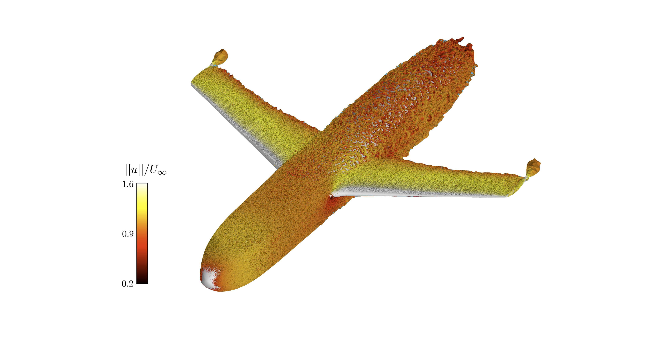
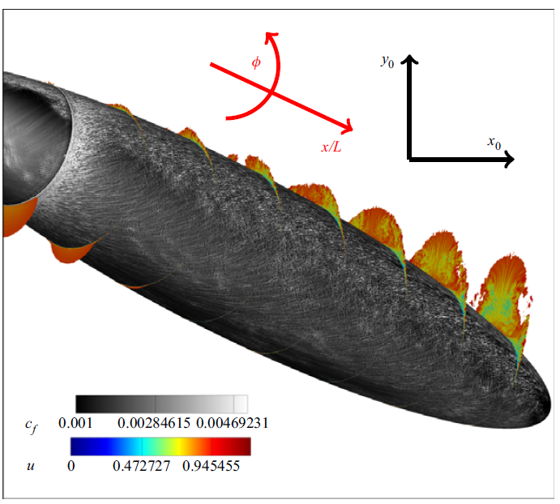
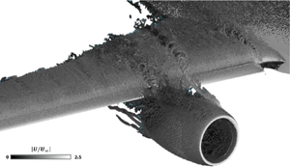
Large Eddy Simulation (LES): a high fidelity tool for engineering applications
Wall modeled LES of an aircraft
Wall resolved LES of a 6:1 prolate spheroid
Isosurfaces of Q-criterion colored by the velocity magnitude
Skin friction (gray contours on surface)
And axial velocity (colored contours on transverse planes)
Left: Lozano-Durán, Bose, & Moin (2022, AIAA)
Plasseraud, Kumar, & Mahesh (2023, JFM)
Right: Goc, Lehmkuhl, Park, Bose, & Moin (2021, Flow)
Notes:
First, what is Large Eddy Simulation? Large eddy simulation is a type of simulation where large scales of the flow are resolved and smaller, more universal scales are model. The result is a high fidelity simulation which can accurately capture complex dynamics not possible by lower fidelity simulations like RANS. You can see examples of this through the pictures shown here which include a wall modeled LES of an entire aircraft and wall resolved LES of a prolate spheroid, similar to a submarine. These types of simulations have only recently been possible, largely due to advances in modeling such as wall models.

Slide 5
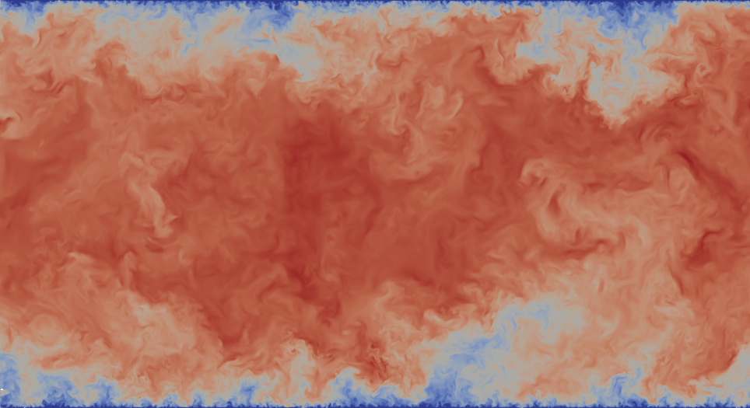
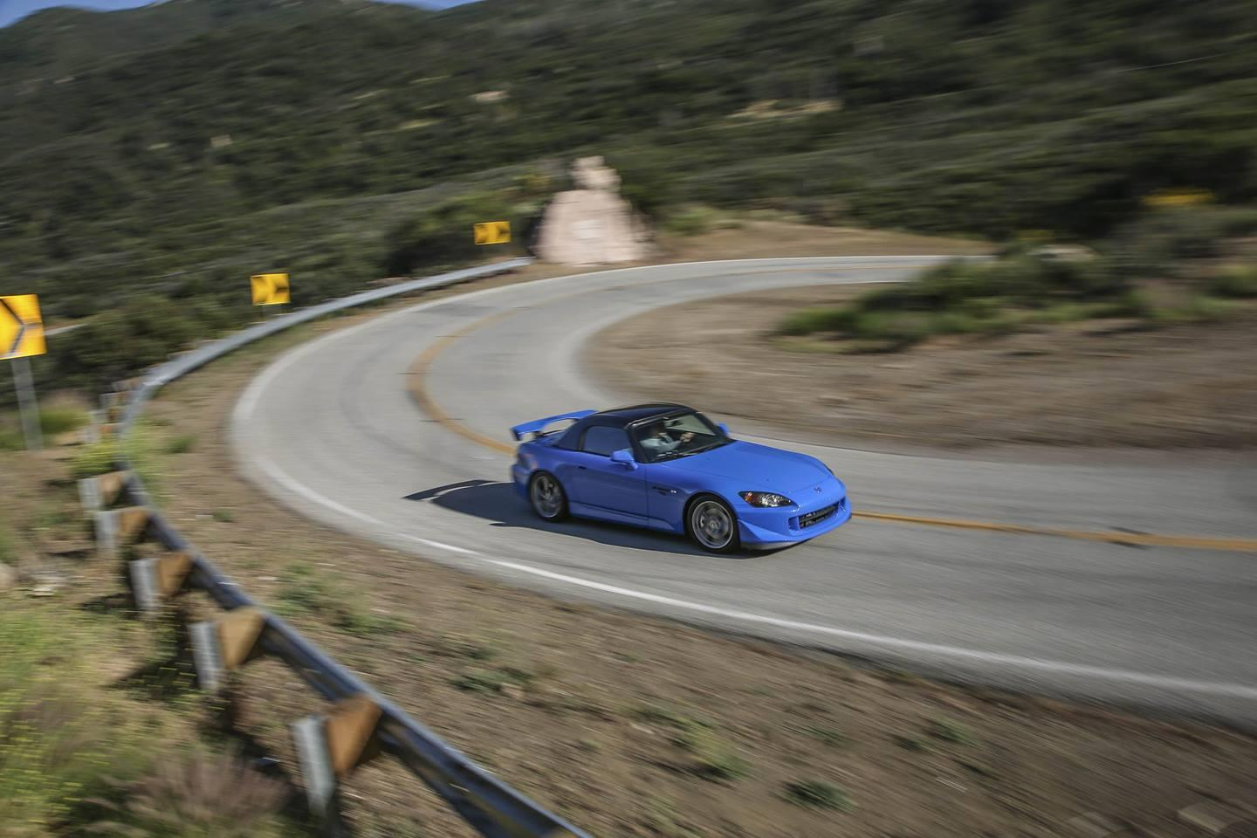
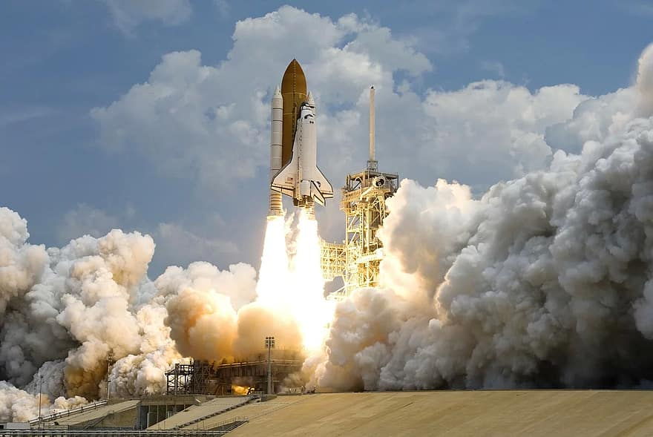
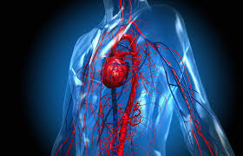
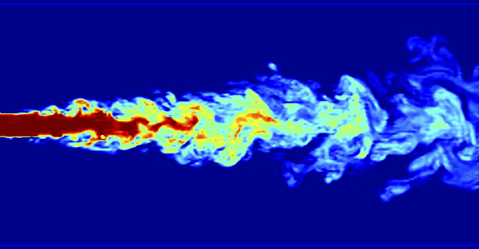
Background/Motivation
Unsteady flows are everywhere
Change in direction
of mean flow
Statistically stationary
turbulent flow
Change in magnitude of mean flow
Real world
example
Test case
example
Sudden spanwise
pressure gradient
Accelerating/decelerating
channel flow
Any steady,
turbulent flow
Pulsatile pipe flow
Notes:
The primary application and motivation for this work is unsteady flows. Here you can see there are a variety of examples of where unsteadiness occurs which can be categorized as changes in direction and magnitude of mean flow like the three images on the left, and even statistically stationary turbulent flow inherently has unsteadiness.

Slide 6
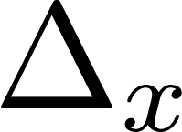
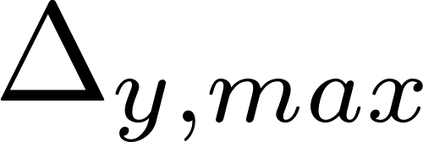
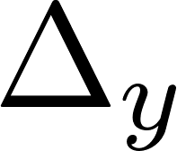
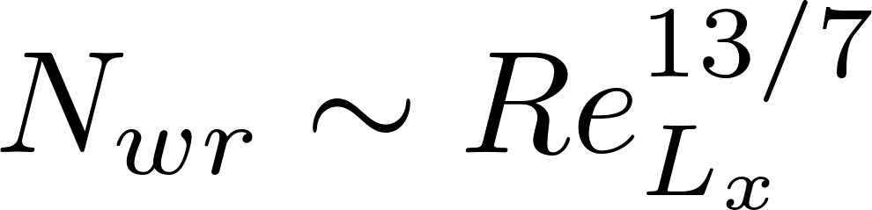
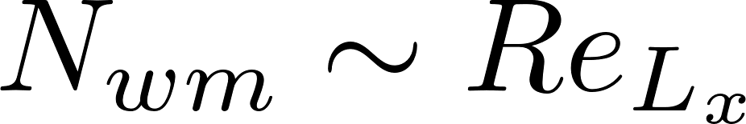
Background/Motivation
Wall Resolved LES
Wall Modeled LES
Near wall grid
refinement
Near wall effects
modelled
Choi & Moin (2012)
Physics of Fluids, 24(1), 011702
grid point requirements for a
turbulent boundary layer
Nearly $O\left(Re_{L_{x}}\right)$ reduction in number of points required
Notes:
On the left you can see what a typical mesh looks like for wall resolved LES where there is near-wall grid refinement. And on the right you can see a wall modeled LES mesh where no near-wall grid refinement is needed because this inner layer is modeled. The result is simulation cost savings. Choi and moin showed that wall modeled LES achieves a Reynolds number reduction in the number of grid points required compared to wall resolved LES.

Slide 7
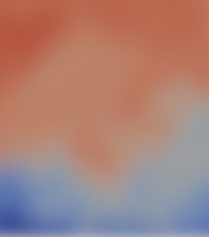
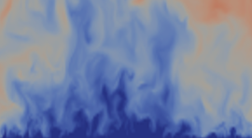
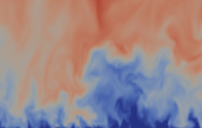






Background/Motivation
Wall modeled LES
$$U_{LES}, ∇p_{LES}$$
unresolved
near-wall
dynamics
wall-modeling height
$$y$$
$$Δ$$
$$x$$
$$τ_{w}$$
$$z$$
Goal: find wall-stress, $τ_{w}$, given LES inputs (e.g. $U_{LES}$ or $∇p_{LES}$)
Notes:
The goal of a wall model is to compute the wall stress given LES inputs (such as the velocity and pressure gradient) at the wall model height, \Delta. This is difficult because there are many complex, near-wall dynamics not resolved by the LES that affect the wall stress.

Slide 8
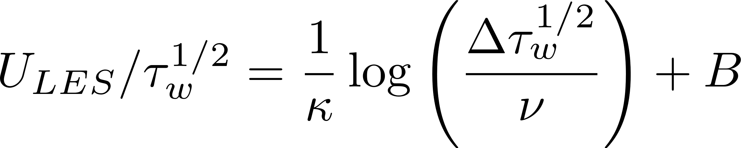
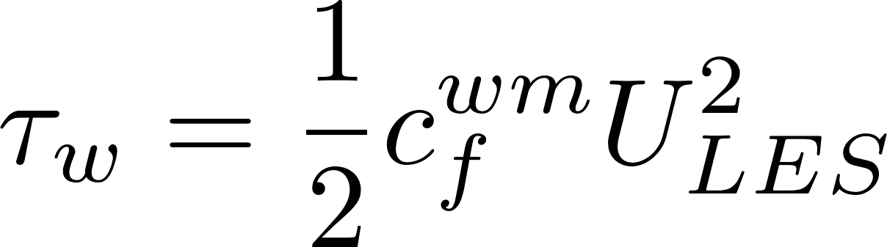





Equilibrium wall model (EQWM)
$$y$$
LES
Log layer
Equilibrium model closure for $τ_{Δ}$ with $U_{LES}=\tilde{u}(y=Δ)$ as input
$$Δ$$
Stresses assumed to be in equilibrium
Wall modeling region
$$τ_{w}=τ_{Δ}$$
wall
time scales
(iteratively solve for $τ_{w}$)
or
where $c_{f}^{wm}\left(\frac{U_{LES}Δ}{ν}\right)$ is fitted (Meneveau 2020, JoT)
Notes:
The most common and popular wall model is the equilibrium wall model. Called such because it assumes stresses are in equilibrium, or in other words the wall stress is set equal to the total stress at the wall model height. Then the wall stress is connected to the LES velocity by assuming some sort of velocity profile profile form such as the log-law where the wall stress must be solved for using an iterative method. Meneveau in 2020 developed several different fitting functions to avoid iteration which we use here.

Slide 9
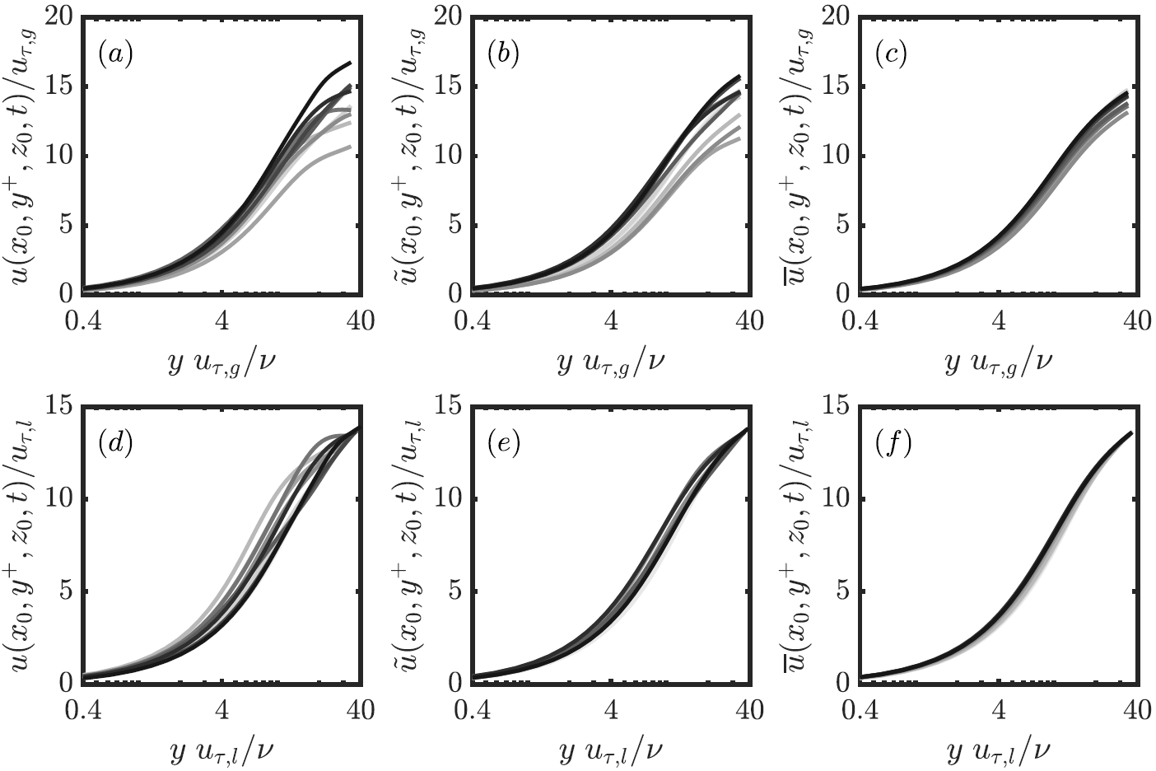
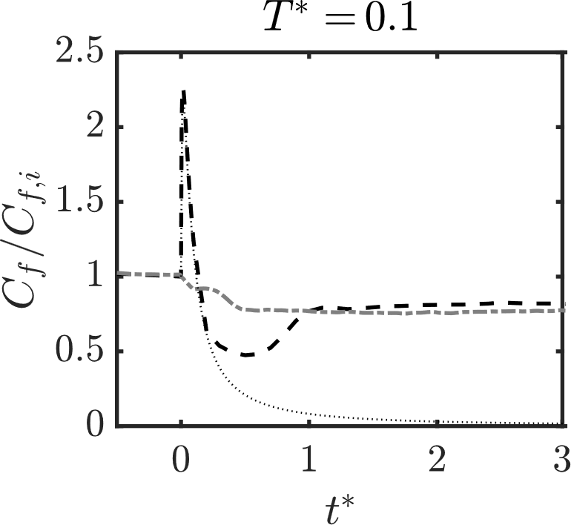
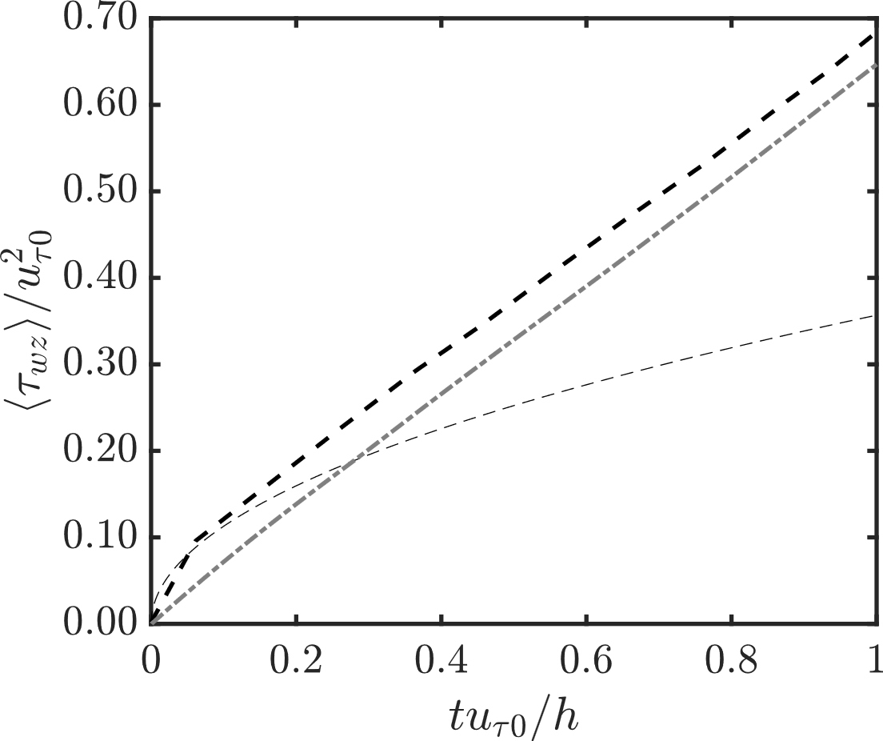
Flows where the EQWM fails
Linearly accelerating
channel flow
Stationary channel flow
Sudden spanwise pressure gradient
DNS (JHTDB)
DNS
EQWM
EQWM
DNS
Laminar
Solution
Laminar solution
DNS from Lozano-Duran et al. 2020, JFM
DNS from Jung & Kim 2017,
Int. J. Heat Fluid Flow
The EQWM fails in a variety of situations.
It appears advantageous to separate equilibrium and non-equilibrium wall stress contributions!
Instantaneous velocity profiles do not collapse!
Notes:
Despite its popular usage, the equilibrium wall model fails in a variety of situations.

Slide 10
Chapter 2 – The Lagrangian Relaxation Towards Equilibrium (LaRTE) model

Slide 11
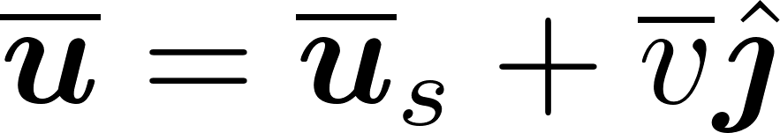
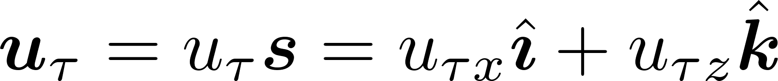
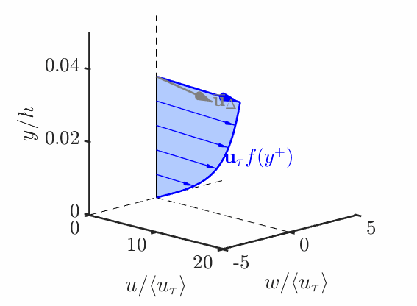









The Lagrangian relaxation towards equilibrium (LaRTE) wall model
Model intended to capture quasi-equilibrium dynamics
Main ansatz: velocity satisfies the law of the wall
Goal: develop evolution equation for
  Wall stress: ${\overline{τ}}_{w}=u_{τ}u_{τ}$
where
$$y$$
$${\overline{τ}}_{Δ}$$
$${\overline{u}}_{Δ}=U_{LES}−u_{Δ}^{′′}$$
$$Δ$$
$${\overline{u}}_{s}\left(y^{+}\right)=u_{τ}f(y^{+})$$
$$x$$
$${\overline{τ}}_{w}=u_{τ}u_{τ}=u_{τ}^{2}s$$
$$z$$
Velocity profile produced using LES simulation data
Notes:
The friction slowly varies in time and space.
For picture: velocity profile is assumed to satisfy law of the wall below the wall modeling height y = Delta
Below you can a schematic and animation demonstrating the usefulness of this approach. The LES velocity, at our wall model height, Delta, is provided as an input to the wall model. This velocity fluctuates significantly but what we have found is that by assuming the inner layer satisfies the law of the wall we can extract the slower, quasi-equilibrium dynamics.

Slide 12
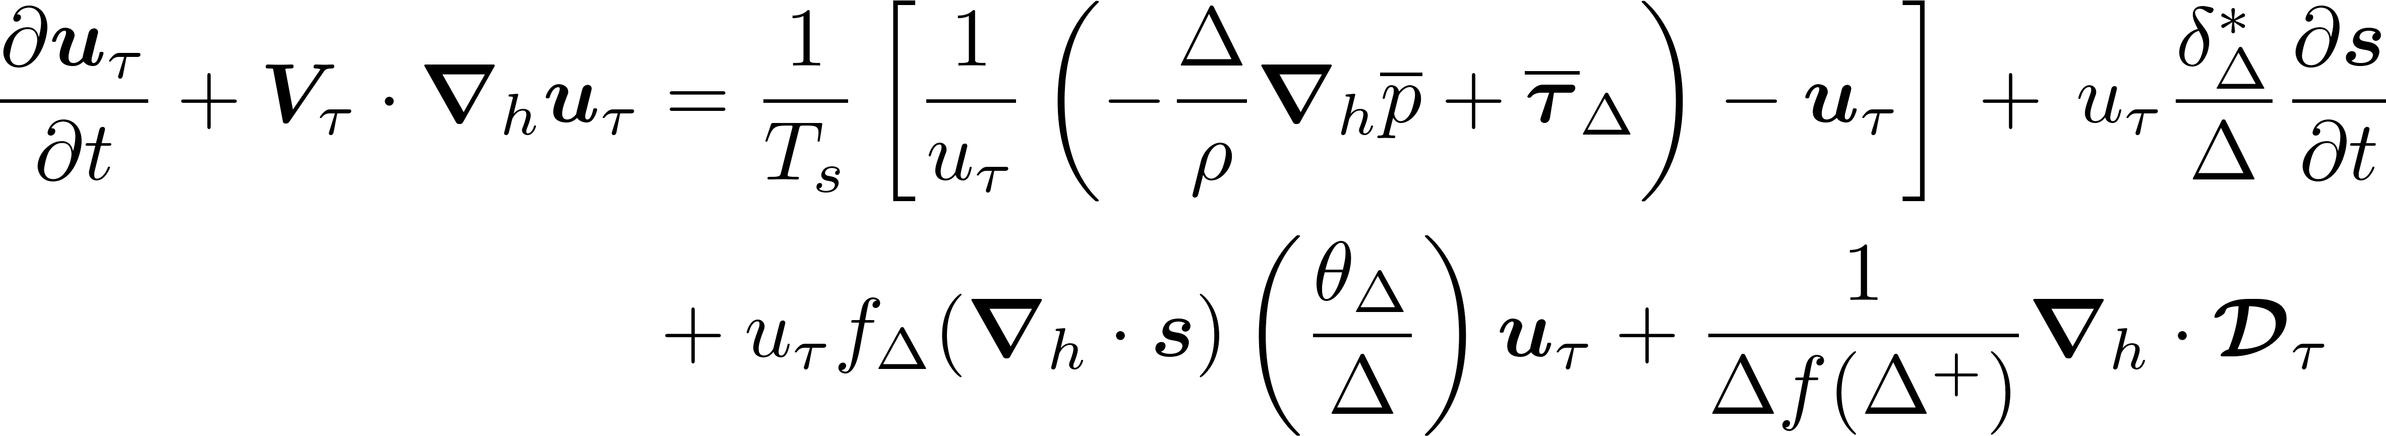
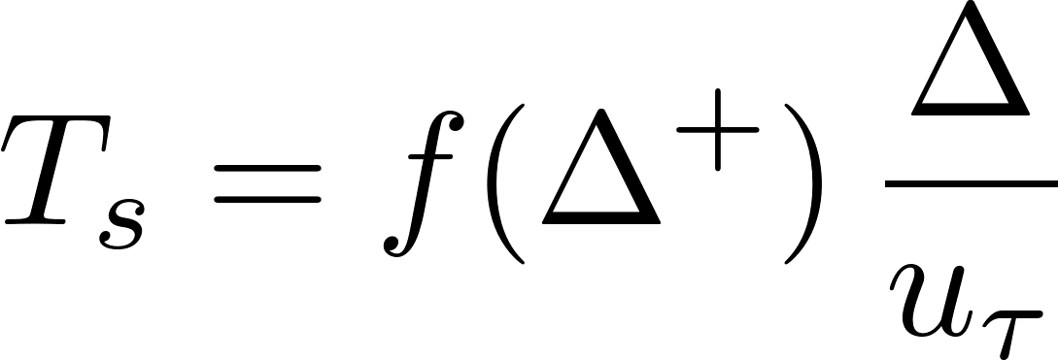
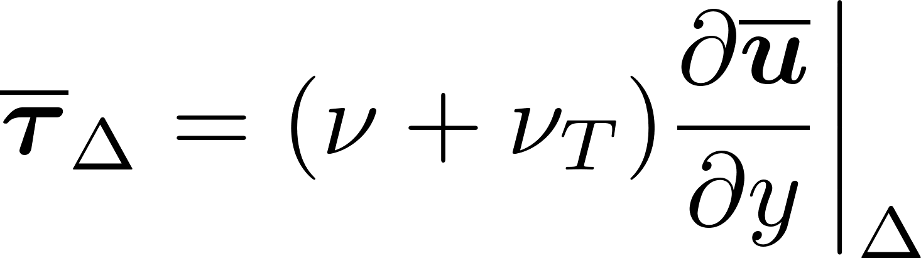



The LaRTE model derivation
Substitute law of the wall velocity profile into RANS eq., $\int_{0}^{Δ}{\left[⋅\right] dy}$, use continuity, and simplify*
“important terms”
where
Equilibrium stress closure: $\frac{1}{u_{τ}}\left(−\frac{Δ}{ρ}∇_{h}\overline{p}+{\overline{τ}}_{Δ}\right)$
$${\overline{τ}}_{w}^{eq}$$
*This is a wall-parallel plane 2D PDE at LES-resolution, i.e. very small additional cost.
Notes:
We can describe the friction velocity as a Lagrangian relaxation towards its equilibrium value

Slide 13
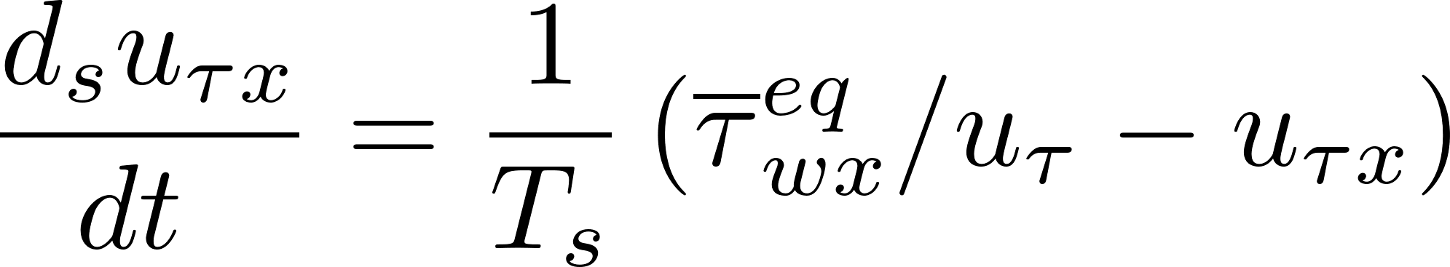
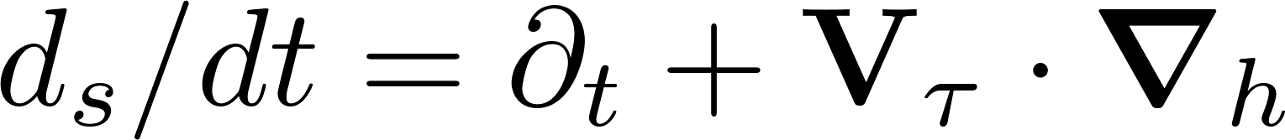
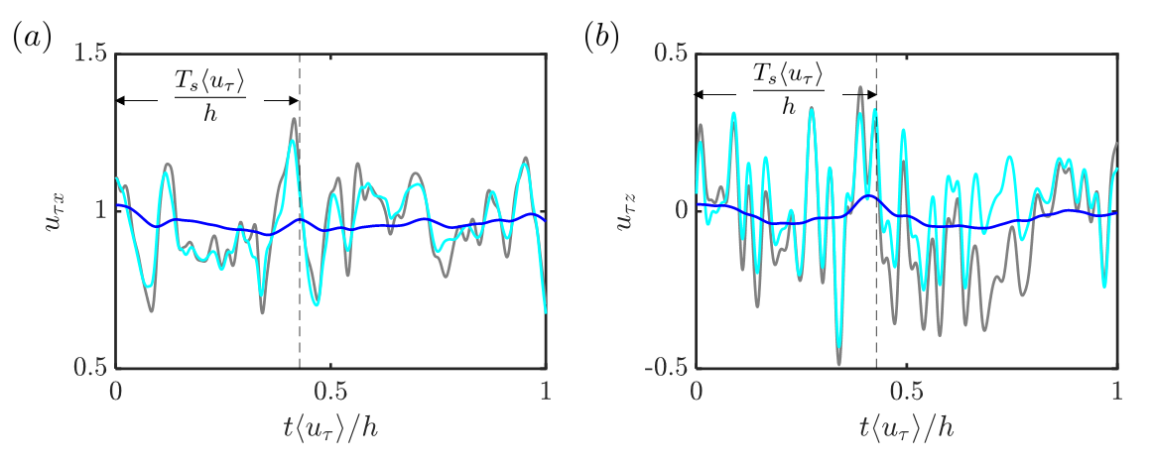
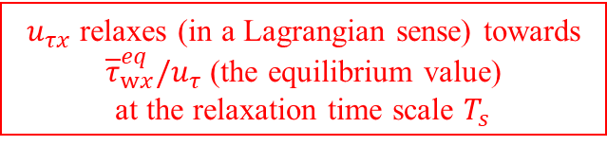







LaRTE wall model
$${\overline{τ}}_{Δ}⋅s$$
Simplified form for x-component
where
Inertial fluid
layer
$$y$$
$$s$$
$${\overline{τ}}_{w}$$
For true equilibrium (the limit $T_{s}→0$): $u_{τ}={\overline{τ}}_{w}^{eq}/u_{τ}$
Real simulation results
For quasi-equilibrium:
$$u_{τ}$$
$${\overline{τ}}_{w}^{eq}/u_{τ}$$
$$T_{s}$$
EQWM
$u_{τx}$ relaxes (in a Lagrangian sense) towards
${\overline{τ}}_{wx}^{eq}/u_{τ}$ (the equilibrium value)
at the relaxation time scale $T_{s}$
LaRTE

Slide 14
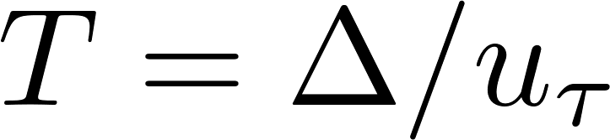
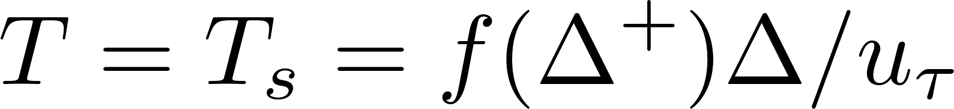
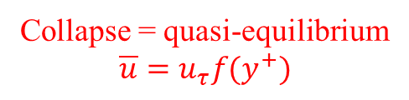

LaRTE a priori test
DNS velocity data from JHTDB filtered at various time scales
  Is $T_{s}$ consistent with quasi-equilibrium?
Global normalization
(constant in time)
Local normalization
(time dependent)
Collapse = quasi-equilibrium
$$\overline{u}=u_{τ}f(y^{+})$$
No filter

Slide 15




LaRTE length and time scale schematic
$$y$$
LES
Log layer
Equilibrium model closure for ${\overline{τ}}_{Δ}$
$$Δ$$
relaxation $∼T_{s}$
Wall modeling region
Quasi-equilibrium (LaRTE)
$${\overline{τ}}_{w}$$
$$T_{s}$$
(relaxation time scale, slow)
time scales
$$τ_{w}=τ_{w}^{′′}+τ_{w}^{′}+{\overline{τ}}_{w}$$

Slide 16
Chapter 3 – the laminar non-equilibrium (lamNEQ) model

Slide 17
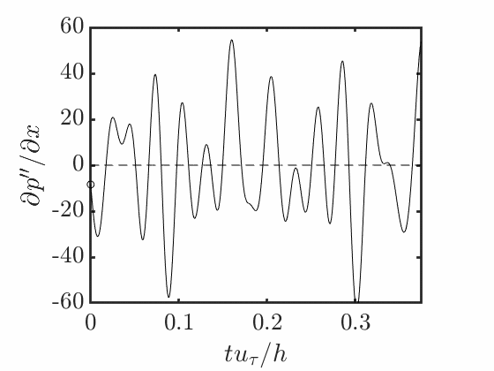
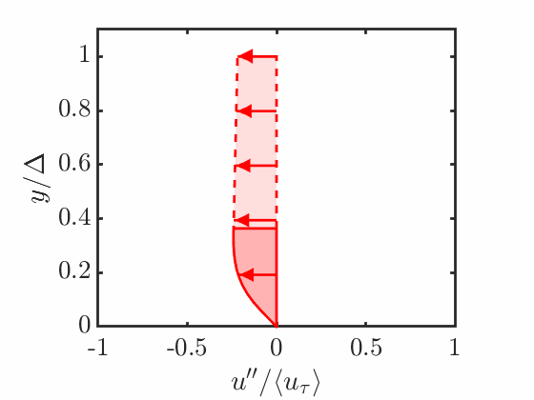
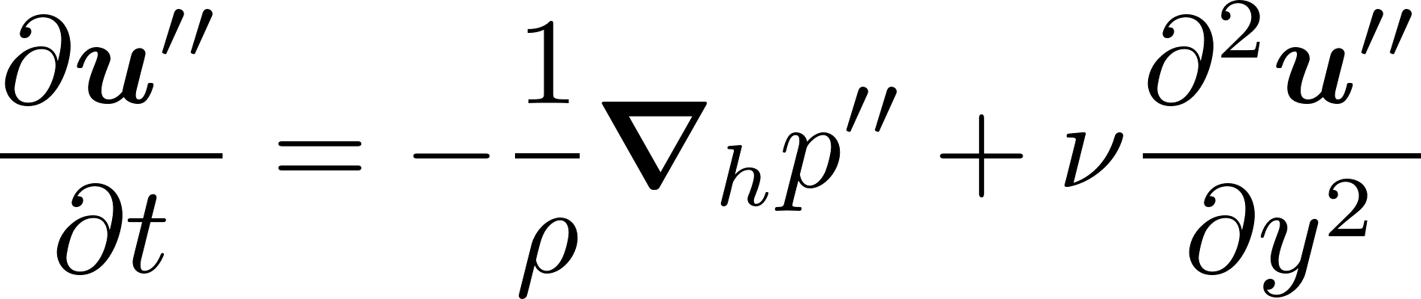
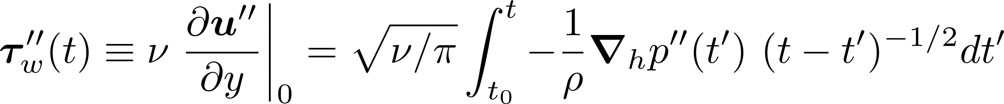
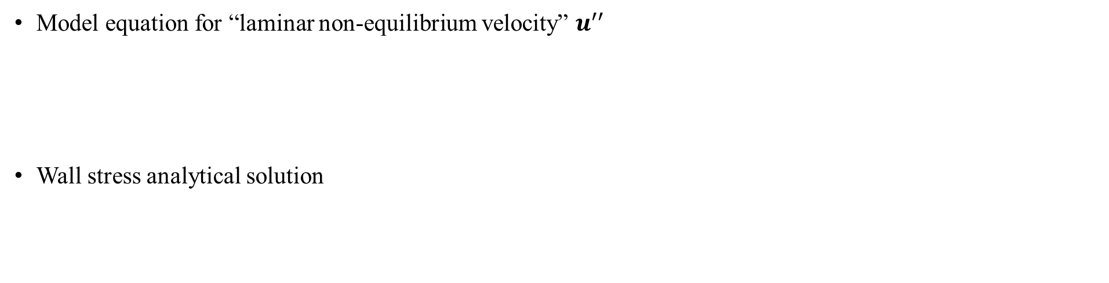

The laminar non-equilibrium (lamNEQ) model
$$u_{Δ}^{′′}$$
High frequency content
of the LES PG:
Velocity response to PG:
Laminar viscous sublayer
Model equation for “laminar non-equilibrium velocity” $u^{′′}$
Wall stress analytical solution

Slide 18
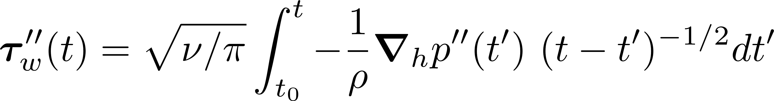
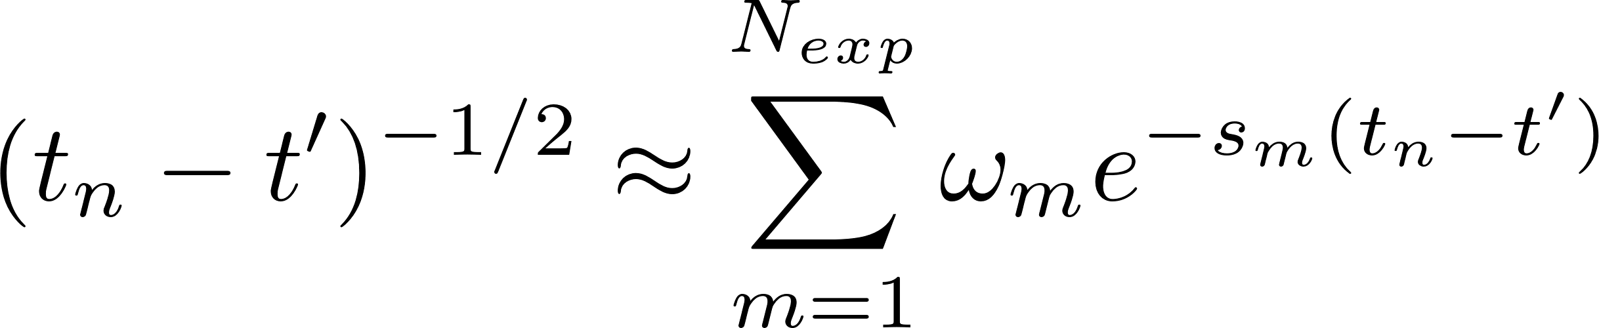
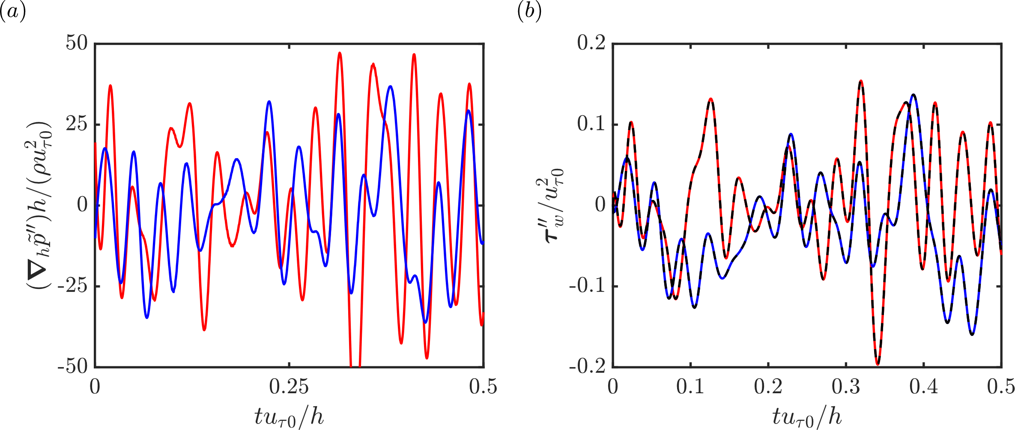
The laminar non-equilibrium (lamNEQ) model
Efficient evaluation is possible through a sum-of-exponentials (SOE) approximation to the kernel, Jiang et al. 2017
(where $ω_{m}$ and $s_{m}$ are constants computed a-priori)
Allows convolution integral to be computed recursively
Dashed Lines – L1 Method (“truth”)
Solid Lines – SOE approx.
Pressure gradient input
Wall stress output

Slide 19
Chapter 4 – Applications of the LaRTE+lamNEQ wall model to equilibrium and non-equilibrium channel flows

Slide 20




LaRTE + lamNEQ length and time scales
$$y$$
LES
Log layer
Equilibrium model closure for ${\overline{τ}}_{Δ}$
$$Δ$$
Laminar
Stokes
layer
relaxation $∼T_{s}$
Wall modeling region
$$l_{s}$$
Quasi-equilibrium (LaRTE)
Viscous
sublayer
$$τ_{w}^{′′}$$
$${\overline{τ}}_{w}$$
$$t_{ν}$$
$$T_{s}$$
(relaxation time scale, slow)
time scales
(viscous time scale, fast)
$$τ_{w}=τ_{w}^{′′}+τ_{w}^{′}+{\overline{τ}}_{w}$$

Slide 21
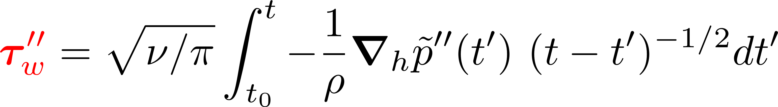
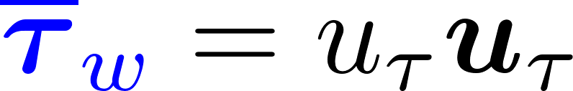
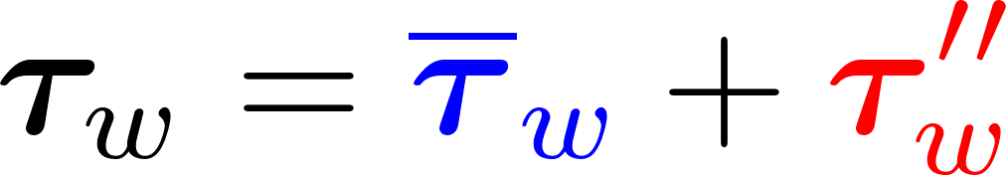
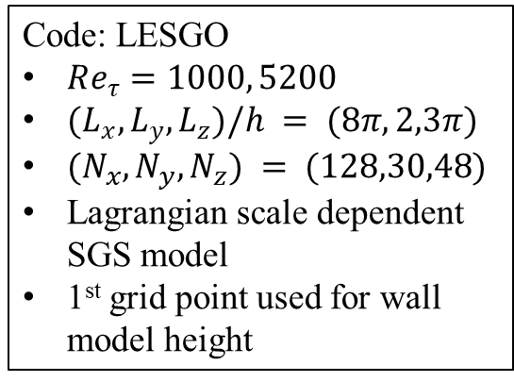

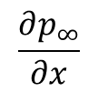

A posteriori tests
LaRTE
lamNEQ
Total wall stress is applied as the boundary condition to the LES
Statistically stationary channel flow
Code: LESGO
$Re_{τ}=1000, 5200$
$(L_{x},L_{y},L_{z})/h = (8π,2,3π)$
$(N_{x},N_{y},N_{z}) = (128,30,48)$
Lagrangian scale dependent SGS model
1st grid point used for wall model height
$$\frac{∂p_{∞}}{∂x}$$
$$2h$$
$$⟨u⟩$$
19

Slide 22









Test simulations – statistically stationary channel flow
Statistics
Time signals
Lagrangian vs Eulerian relaxation
EQWM
LaRTE
$$Re_{τ}=1000$$
lamNEQ
LaRTE
DNS
LES
Lagrangian
Eulerian
$$Re_{τ}=5200$$
$$τ_{wx}$$
$$τ_{wz}$$
(same initial condition coming from the Lagrangian simulation)

Slide 23







A posteriori tests
LaRTE
lamNEQ
Total wall stress is applied as the boundary condition to the LES
Channel flow with sudden spanwise pressure gradient (SSPG)
Code: LESGO
$Re_{τ0}=1000$
$(L_{x},L_{y},L_{z})/h = (8π,2,3π)$
$(N_{x},N_{y},N_{z}) = (128,30,48)$
Lagrangian scale dependent SGS model
1st grid point used for wall model height
$$t<0$$
$$t≥0$$
$$⟨w⟩$$
$$\frac{∂p_{∞}}{∂z}=10\frac{∂p_{∞}}{∂x}$$
$$⟨u⟩$$
$$\frac{∂p_{∞}}{∂x}$$
19

Slide 24




Test simulations – sudden spanwise pressure gradient
Large spanwise pressure gradient ($∂p_{∞}/∂z=10 ∂p_{∞}/∂x$) applied for $t≥0$
Wall stress response
DNS
LES
Wall stress contour animation
LaRTE
lamNEQ

Slide 25
Chapter 5 – The multi-time-scale wall model (MTSWM)

Slide 26
LaRTE+lamNEQ wall stress probability density functions
lamNEQ
LaRTE
DNS
LES
Streamwise wall stress fluctuations underpredicted!

Slide 27
LaRTE + lamNEQ length and time scales
$$y$$
LES
Log layer
Equilibrium model closure for ${\overline{τ}}_{Δ}$
$$Δ$$
Laminar
Stokes
layer
relaxation $∼T_{s}$
Wall modeling region
$$l_{s}$$
Quasi-equilibrium (LaRTE)
Viscous
sublayer
$$τ_{w}^{′′}$$
$${\overline{τ}}_{w}$$
$$t_{ν}$$
$$T_{s}$$
(relaxation time scale, slow)
time scales
Missing physics to be modeled!
(viscous time scale, fast)

Slide 28















Turbulent non-equilibrium (turbNEQ) model
$$y$$
$${\overline{τ}}_{Δ}$$
Wall attached
eddies
$${\overline{u}}_{Δ}$$
Turbulent velocity fluctuation
$$u_{Δ}^{′}={\overline{u}}_{Δ}−u_{τ}f(Δ^{+})$$
$$Δ$$
$${\overline{u}}_{s}\left(y^{+}\right)=u_{τ}f(y^{+})$$
$$x$$
High momentum streak
$${\overline{τ}}_{w}=u_{τ}u_{τ}=u_{τ}^{2}s$$
Low momentum streak
$$z$$
High momentum streak
Velocity profile agrees
with POD mode shown in
Hansen et. al 2022,
(CTR Summer Program 2022)
for $y≥l_{s}$
for $0≤y≤l_{s}$

Slide 29


Multi-time-scale (MTS) wall model
$$y$$
LES
Log layer
Equilibrium model closure for ${\overline{τ}}_{Δ}$
$$Δ$$
Laminar
Stokes
layer
relaxation $∼T_{s}$
Turbulent
non-
equilibrium
Wall modeling region
$$l_{s}$$
Quasi-equilibrium (LaRTE)
Viscous
sublayer
$$τ_{w}^{′′}$$
$$τ_{w}^{′}$$
$${\overline{τ}}_{w}$$
$$t_{ν}$$
$$T_{s}$$
(relaxation time scale, slow)
time scales
(viscous time scale, fast)
$$τ_{w}=τ_{w}^{′′}+τ_{w}^{′}+{\overline{τ}}_{w}$$

Slide 30
Chapter 6 – The MTSWM applied to horizontally homogeneous flows
Notes:
Flows focus on temporal non-equilibrium

Slide 31

Revising wall stress probability density functions with MTSWM
lamNEQ
DNS
LaRTE
LES
turbNEQ
Streamwise wall stress fluctuations match DNS!
Overpredicts spanwise variance

Slide 32





The MTSWM applied to non-equilibrium flows
Pulsatile channel flow
MTS wall stress BC
Primary DNS reference: Weng et al. (2016)
PG forcing:
$$τ_{w}={\overline{τ}}_{w}+τ_{w}^{′}+τ_{w}^{′′}$$
Total = LaRTE + turbNEQ + lamNEQ
Non-equilibrium parameter: frequency

Slide 33


JFM Notebooks
Fowler, Zaki, Meneveau (2023), JFM,
DOI: https://doi.org/10.1017/jfm.2023.585
Notes:
First, as a bit of a shameless plug, the results for this chapter were recently published in a paper which uses JFM notebooks.

Slide 34







Pulsatile channel flow
$$ω_{f}^{+}=0.001$$
$$ω_{f}^{+}=0.003$$
$$ω_{f}^{+}=0.006$$
Wall stress
DNS
MTSWM
EQWM
$$ω_{f}^{+}=0.01$$
$ω_{f}^{+}=0.$02
$$ω_{f}^{+}=0.04$$
Wall stress

Slide 35

Pulsatile channel flow
$$ω_{f}^{+}=0.001$$
$$ω_{f}^{+}=0.003$$
$$ω_{f}^{+}=0.006$$
LaRTE
Intermediate frequency
Wall stress
lamNEQ
Quasi-steady
turbNEQ
DNS
MTSWM
LaRTE
$$ω_{f}^{+}=0.01$$
$ω_{f}^{+}=0.$02
$$ω_{f}^{+}=0.04$$
lamNEQ
turbNEQ
Wall stress
High frequency

Slide 36














The MTSWM applied to non-equilibrium flows
Linearly accelerating channel flow
DNS reference: Jung & Kim (2017)
PG forcing:
Laminar stage
$$Re_{m}$$
(initial turbulent state)
(final turbulent state)
time
Transition stage
From Jung & Kim (2017)
Non-equilibrium parameter: “acceleration/ramp rate”
Final turbulent state

Slide 37


Linearly accelerating channel flow
Laminar stage
Transition stage
DNS
Final turbulent state
MTSWM
EQWM
Laminar solution

Slide 38


Linearly accelerating channel flow
DNS
lamNEQ
LaRTE
MTSWM
LaRTE
turbNEQ
lamNEQ
turbNEQ

Slide 39
Chapter 7 – The MTSWM applied to streamwise developing flows
Notes:
Previous tests have focused on temporal non-equilibrium. Now we want to test spatial non-equilibrium.

Slide 40



LESGO code development
Fringe Body Force
$u^{t}$ computed using modified rescale-recycle method based on Lund et al. (1998)

Slide 41



Zero pressure gradient (ZPG) turbulent boundary layers over a wide range of Reynolds numbers
Code: LESGO
$(L_{x},L_{y},L_{z})/h = (8π,2,3π)$
$(N_{x},N_{y},N_{z}) = (128,30,48)$
Lagrangian scale dependent SGS model
1st grid point used for wall model height
$$δ_{99}(x)$$
Based on WMLES of Inoue and Pullin (2011)
$Re_{θ_{0}}$ prescribed using modified rescale-recycle method

Slide 42




ZPG statistics over a wide range of Re
LES agrees with empirical trends
Turbulence intensities collapse
MTSWM
EQWM
$$⟨u^{′2}⟩$$
Empirical Fit
MTSWM
$$⟨v^{′2}⟩$$
EQWM

Slide 43



ZPG statistics over a wide range of Re
Empirical Fit $±10\%$
Empirical Fit $±5\%$
MTSWM
EQWM
Skin friction falls within 10% of expectation

Slide 44




Separation bubble induced by suction and blowing boundary condition
Based on DNS of Coleman et al. (2018)
Suction
ZPG1
Blowing
ZPG2
$$V_{top}(x)$$
$$δ_{99}(x)$$
$V_{top}$ prescribed

Slide 45

Separated flow simulation results
DNS
MTSWM
EQWM

Slide 46

Separated flow simulation results
DNS
MTSWM
EQWM

Slide 47
Separated flow simulation results
DNS
MTSWM
EQWM
LES does not show mean flow separation

Slide 48

Separated flow simulation results
$γ_{r}$ = fraction of reversed wall stress (fraction of time $τ_{wx}<0$)
DNS
MTSWM
EQWM

Slide 49

Separated flow simulation results
$γ_{r}$ = fraction of reversed wall stress (fraction of time $τ_{wx}<0$)
MTSWM more realistically predicts wider $γ_{r}$ than EQWM
DNS
MTSWM
EQWM

Slide 50

Separated flow simulation results
Total
LaRTE
lamNEQ
turbNEQ

Slide 51

Separated flow simulation results – MTSWM PDFs
Total
LaRTE
lamNEQ
turbNEQ

Slide 52
Chapter 8 – Summary, conclusions, and future directions

Slide 53

Summary and conclusions
Developed a multi-time-scale wall model for non-equilibrium LES
  LaRTE – captures slow, quasi-equilibrium wall stress behavior
  lamNEQ – captures wall stress response to fast changes in PG affecting laminar Stokes layer dynamics
  turbNEQ – captures wall stress response to velocity fluctuations characteristic of turbulent eddies
Tested MTSWM for a wide range of flow conditions from quasi-equilibrium to non-equilibrium and compared against EQWM and available DNS
  Includes stationary channel flows, channel flow with SSPG, pulsatiling channel flow, linearly accelerating channel flow, ZPG developing boundary layer, and a separated boundary layer
  MTSWM clearly outperforms EQWM during high non-equilibrium conditions (high frequency / fast acceleration)
  Pulsating & Linearly accelerating flows show usefulness of the MTSWM approach
    Different components capure different time scale dynamics
  LES for ZPG boundary layer and separated flow tests show good agreement with DNS
    MTSWM more realistically predicts wider $γ_{r}$ than EQWM

Slide 54

Future directions & publications
Expand application cases
  Flows with larger separation
  Combined temporal and spatial non-equilibrium
  Complex geometry
Continue improving models
  Extend to rough walls
  Improve spanwise PDFs
  Develop alternate turbNEQ models
Code improvement
  Fringe region generates large PG at inlet
  Improve performance in fringe region
Additional details can be found in:
Fowler, Zaki, Meneveau (2022), JFM,
DOI: https://doi.org/10.1017/jfm.2021.1156
Fowler, Zaki, Meneveau (2023), JFM,
DOI: https://doi.org/10.1017/jfm.2023.585

